Slide 1

http://www.free-powerpoint-templates-design.com

Slide 2
Contents
01
Objectives, Problem and solution
02
Data Management Plan
03
Demo

Slide 3
We Create
Smart Recommendation Engine
Defining Visitors needs
The Problem
Matching needs with available products
Providing Customized shopping journey

Slide 4
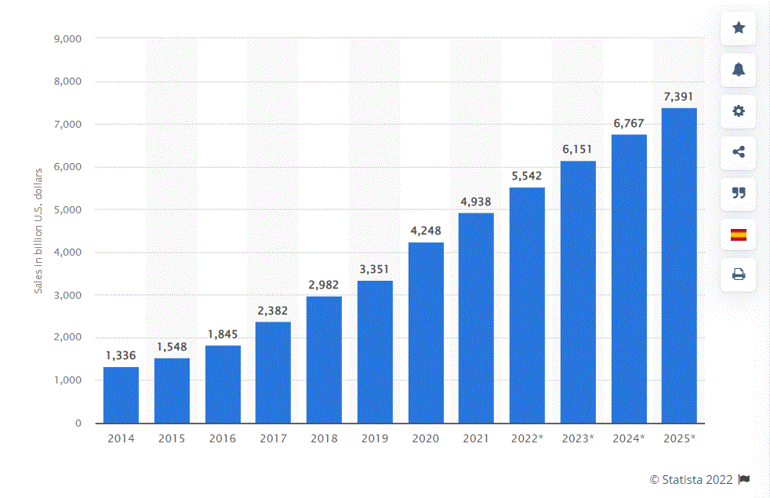
Retail e-commerce sales worldwide from 2014 to 2025

Slide 5
Performance
Revenue
Real Time recommendation
Customer Satisfaction

Slide 6
E-Commerce Platforms
Electronics
Subscriptions
Direct Sales
Mena
50 K $
Revenue Model
Targeted Customers
Initial Investment
Market
Go to Market

Slide 7


Slide 8
Data Management Plan

Slide 9
Data Source and Data Type
Data Source
Amazon Electronics dataset
21 million reviews (JSON Format)
Future
Data will be extracted from Customer Data Base
Data types
- Reviews Data
- Product Data
- Meta data

Slide 10
Policies
Access, Sharing, Reuse, and Data Redistribution
The costumers
will have an access to dashboard that shows some insights about the site visitors search and journey. They also have full access on their databases, so they can delete the data from the local and cloud servers.
The data will be collected and maintained on a cloud server (S3 Service), and it will be accessed by the administrators and the data owners (costumers) by creating accounts for these users with two factors of authentication for security purposes , due to the sensitivity of this data (costumers and sales data are very sensitive for retails).
The administrators
will have full access on the data and the coder to tune and fix the bugs. Also, to integrate the systems APIs, clouds to save the data.

Slide 11
Data Storage, Archiving and Preservation.
The generated data will be maintained in data repository (data warehouse) for archiving, future analyzing, and reporting.
For security issues, we will develop comprehensive access rules (two factors of authentication) to allow only authorized users with a legitimate business need to access, modify, or transmit data.

Slide 12


Slide 13

Thank You

